Slide 1
INTRO TO OOP
Life Choices Coding Academy 2020

Slide 2
Learning outcome:
By the end of this section, student should be able to:
Define classes in Python.
Define methods in Python.
List the advantages of OOP.
Understand what an object is in Python.
Explain the concept of polymorphism.

Slide 3
Programming languages
Programming languages allow programmers to code software.
The three major families of languages are:
- Machine languages
- Assembly languages
- High-Level languages
Notes:
Machine
Comprised of 1s and 0s.
The “native” language of a computer.
Difficult to program - one misplaced 1 or 0 will cause the program to fail.
Assembly
Assembly languages are a step towards easier programming
Assembly languages are comprised of a set of elemental commands which are tied to a specific processor.
Assembly language code needs to be translated to machine language before the computer processes it
EG: 1001010, 1011010
High Level
High-level languages represent a giant leap towards easier programming.
The syntax of HL languages is similar to English.
Historically, we divide HL languages into groups (Procedural, OOP)

Slide 4
Why Object-oriented Programming?
Ability to simulate real-world event much more effectively.
Code is reusable thus less code may have to be written.
Data becomes active.
Programmers are able to produce faster, more accurate and better written applications.

Slide 5
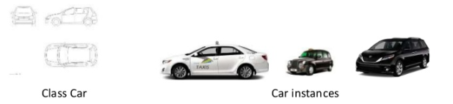
Object-oriented programming
Most object-oriented languages are high-level languages.
The focus of OOP languages is not on structure, but on modeling data.
Programmers code using blueprints of data models called classes.
Examples of OOP languages include c++, Java, Python etc.

Slide 6
Object Oriented Programming
Object - Unique programming entity that has methods, attributes and can react to events. Is an instance of a class
Class - is a blueprint from which objects are made.
Method - Things which an object can do; the “verbs” of objects.
Attribute - Things which describe an object.
Notes:
You can use a Car example here.
Object - Car
Method - drive(), takeTurn(), stop()
Attribute - wheels, steering_wheel, accelerator

Slide 7
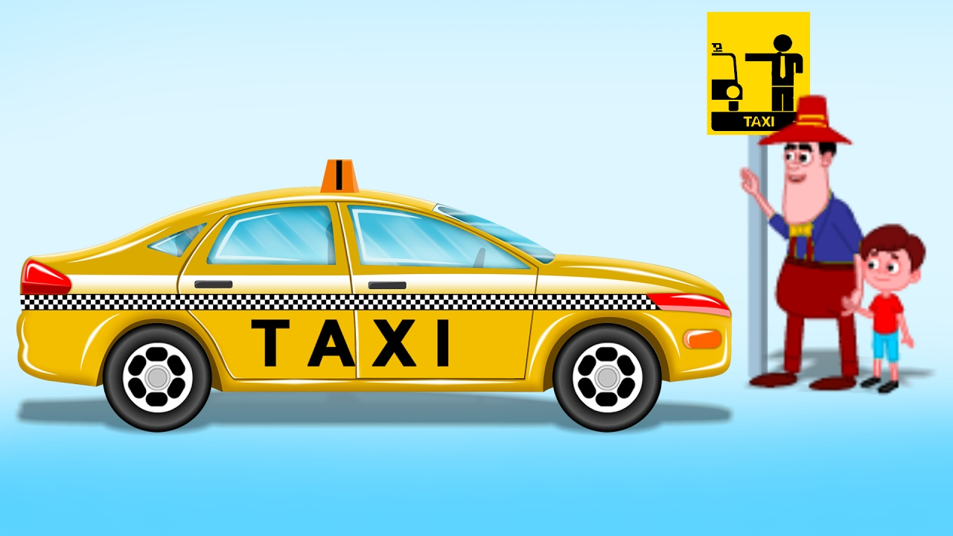
Example Object - Taxi
Every object has two main components:
Data (attributes about it)
Behavior (the methods)
Data
driver_name
on_duty
total_passengers
cities
Behavior
pick_up_passenger
drop_of_passenger
set_driver_name
get_driver_name

Slide 8
Creating a Class in Python
In a class, we describe (1) how the object will look like, and (2) what behavior it will have.
Classes are the blueprints for a new data type in your program!
A class should have at minimum:
A name (e.g Taxi)
A constructor method(describes how to create a new object, __init__)
Notes:
Almost everything in Python is an object, with its properties and methods.
A Class is like an object constructor, or a “blueprint” for creating objects

Slide 9
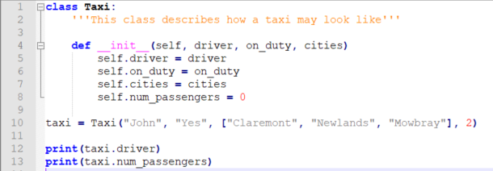
Creating an object from the class
Notes:
To create a class, use the keyword class
All classes have a function called __init__(), which is always executed when the class is being initiated.
Use the __init__() function to assign values to object properties, or other operations that are necessary to do when the object is being created:
Note: The __init__() function is called automatically every time the class is being used to create a new object.

Slide 10
OOP - Encapsulation
Mechanism to restrict access to class attributes.
Data can only be accessed through that package.
Information Hiding
Notes:
Information hiding - process of hiding the details of an object or function. The hiding results in an abstraction.
Give a bank example here. When the bank gives you their API, you will not have access to update say, the balance attribute.

Slide 11
OOP - Polymorphism
A concept that refers to the ability of a variable, function or object to take on multiple forms.
Allows developers to program in the general rather than program in the specific.
Notes:
Think of the python sum function, especially for complex numbers.

Slide 12
OOP - Inheritance
Allows programmers to create new classes based on an existing class.
Methods and attributes from the parent class are inherited by the newly created class.
New methods and attributes can be created in the new class, but don’t affect the parent class’s definition.
Notes:
Demonstrate how a Car class can be useful when it comes to inheritance. Maybe define a new parent class, Vehicle.
For every car or a vehicle you can not have a class with an attribute where you define speed or type etc.

Slide 13
Object Methods
Objects can also contain methods or functions.
Notes:
Lets create a method in the Taxi which calculates taxi fare.
def calculate_fare:
pass

Slide 14
Behavior of a class
classes/objects can have methods just like functions except that they have an extra self variable at the beginning.
An object method takes as the first parameter the object (self) and can accept any number of other parameters
Notes:
See the handout for more details regarding the self parameter.

Slide 15
Exercise time :)

Slide 16
Exercise 1
Write a class that describes a Bus.
Statement: A bus is created with a number of seats, a color, and is driven by a bus driver that has a name.
Instructions:
Create a class for the bus in python as per the statement above.
Create two methods where you can change the color of the bus.
Notes:
Need to demonstrate the basics when when a team has a proper business analysis team or an architecture. Your methods or variables name might be predefined.

Slide 17
Exercise 2: Update your class Bus
As an owner of the bus company, You wish to keep track of the number of busses that people buy (create).
Instructions:
Create a class variable which will allow you to keep track of the bus numbers created.
Increment a class variable on __init__ (hint) method whenever a new Bus is created.

